Slide 1
Artificial Intelligence
Artificial Intelligence(AI) refers to the simulation of human intelligence in machines that are programmed to think like humans and mimic their actions.
Branches of AI are :
Machine Learning
Deep Learning
Natural Language Processing
Robotics
Expert Systems
Fuzzy Logic

Slide 2
Machine Learning
Machine learning(ML) is a type of artificial intelligence that allows software applications to become more accurate at predicting outcomes without being programmed to do so.
Machine Learning algorithms use historical data as input to predict output values.
There are three types of machine learning :
Supervised learning
Unsupervised learning
Reinforcement learning

Slide 3
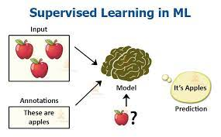
Supervised Learning
When a input is provided as a labelled dataset, a model can learn from it and this kind of learning is called supervised learning.

Slide 4
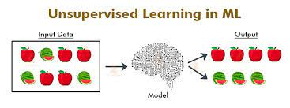
Unsupervised Learning
There is no complete and clean labelled dataset in unsupervised learning.
It is a type of self-organised learning that helps find previously unknown patterns in data sets without pre-existing labels.

Slide 5
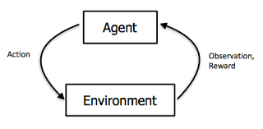
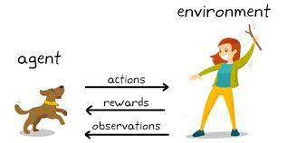
Reinforcement learning
It is about taking suitable action to maximize reward in a particular situation.
It works on basis of a reward and penalty system.

Slide 6
Types of problems in supervised learning
Regression problems
They are responsible for continuous data.
Example: For predicting the price of a piece of land in a given area.
The input is sent to the machine for predicting the price according to previous instances.
The machine them determines a function that would map the pairs.
Classification problems
They ask the algorithm to predict a discrete value that can identify the input data as a member of a particular class or group.
Example: For determining whether a student has passed or failed from a particular set of students.

Slide 7
Components of Machine Learning Algorithm
Features
It refers to the inputs given to the algorithm.
Labels
It refers to the outputs given by the algorithm.
Model
It refers to the mathematical equation used to solve the function.
Example : If input is given as x= (1,2,3,4,5) and output as y=(2,4,6,8,10) the mathematical model formed would be y=2x
INPUT
(Features)
ML Algorithm
OUTPUT
MODEL
(Labels)
(Functions)

Slide 8
Types of ML algorithms
Linear Regression
Non Linear Regression
Logistic Regression
Decision Tree
Random Forest
KNN( K Nearest Neighbours )
SVM ( Support Vector Machine )
Naïve Bayes Algorithm

Slide 9
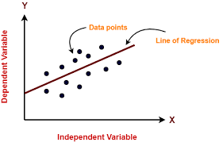
Linear Regression
It is a machine learning algorithm based on supervised learning.
It is a statistical method used for predictive analysis.
It models a target prediction value based on independent variables and is mostly used for finding out the relationship between variables and forecasting.
Here the power of x should be 1

Slide 10
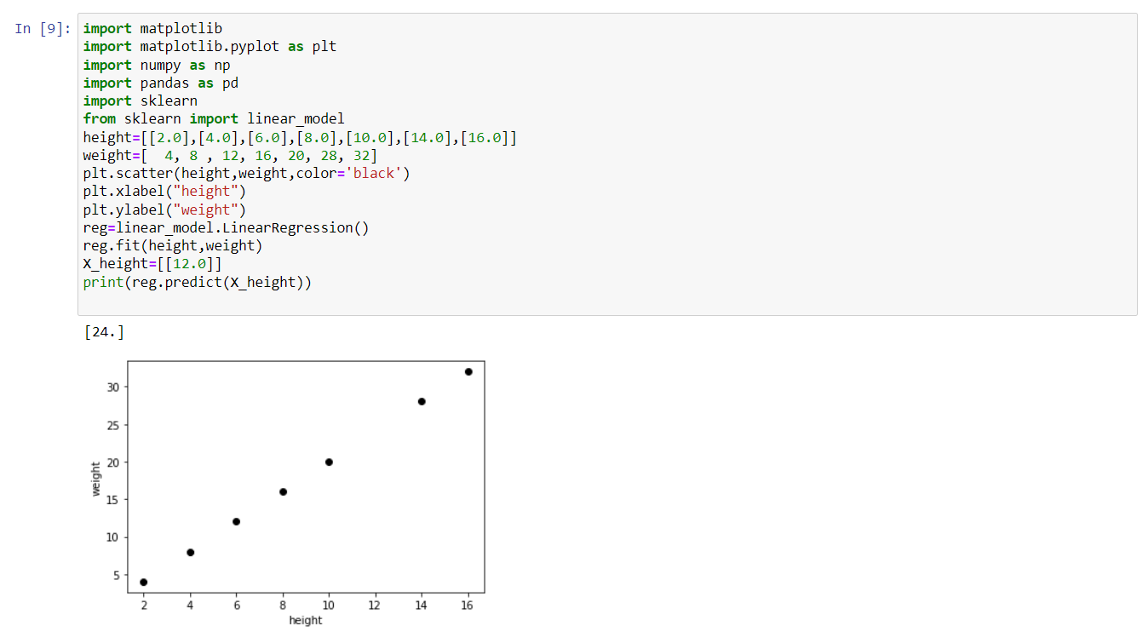
Linear regression Algorithm

Slide 11
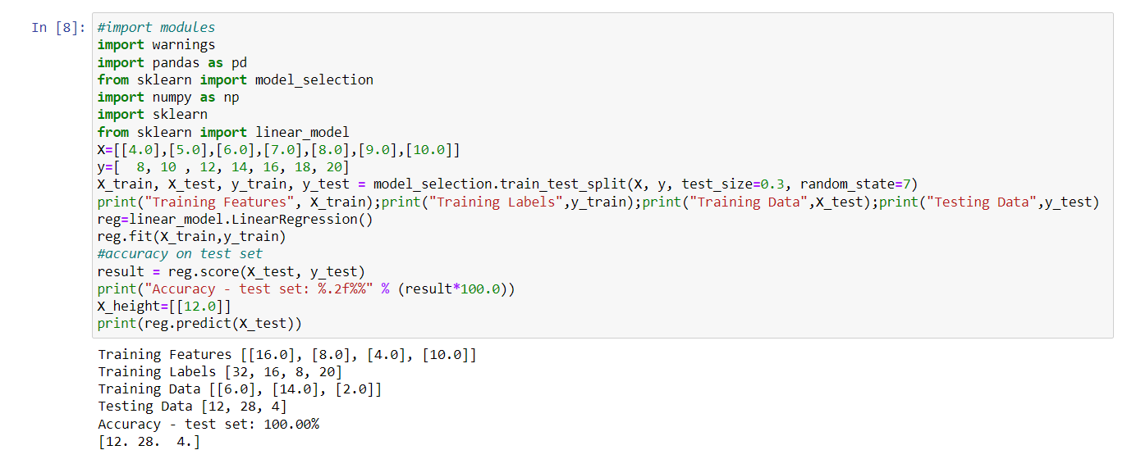
Linear regression Algorithm

Slide 12
Non linear regression
It refers to a regression model that portrays a nonlinear relationship between a dependent variable and independent variables.
It is complex and, at the same time, creates accurate results.
The analysis develops a curve depicting the relationship between variables based on the dataset provided.
Here the power of x is generally more than 1

Slide 13
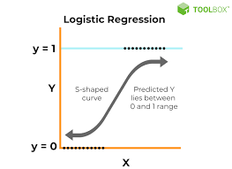
Logistic regression
It is an example of supervised learning which is used to calculate the probability of a binary(yes/no) event occurring.
It is similar to linear regression, except in the way they are used, in that linear regression is used to solve regression problems while logistic regression is used to solve classification problems.
On the graph, it gives an exponential curve unlike a straight line given by the graph of linear regression.

Slide 14
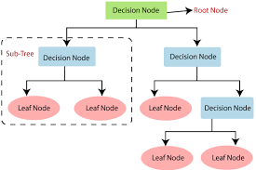
Decision tree
It falls under the category of supervised learning.
They can be used to solve both regression and classification problems
It is graphical representation of all possible solutions and all the decisions are made based on some conditions.

Slide 15
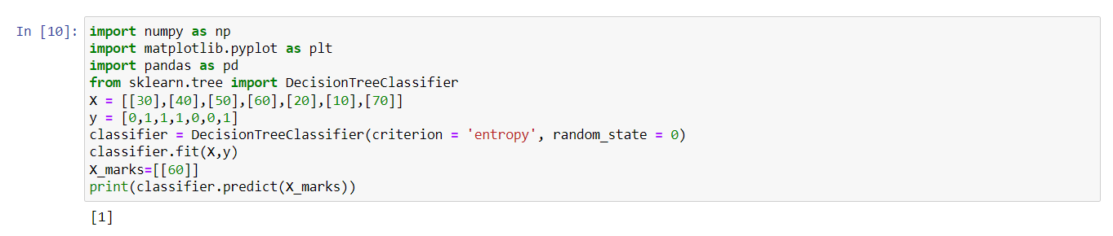
Decision tree algorithm

Slide 16

Random forest
It is a supervised machine learning algorithm that is widely used in Classification and Regression problems.
It builds decision trees on different samples and takes their majority vote for classification and average in case of regression.
One of its important features is that it can handle the data set containing continuous variables in case of regression and categorical variables in case of classification.

Slide 17
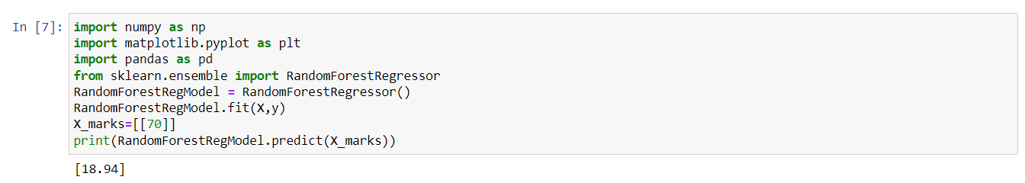
Random Forest algorithm

Slide 18
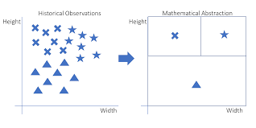
KNN(K nearest neighbours)
It is an algorithm based on supervised learning which assumes the similarity between the new data and puts it into a category which is most similar to the available categories.
It stores all the available data and classifies a new data point based on the similarity, making it easier to classify the new data into a well suited category.
It is mostly used for classification problems.

Slide 19
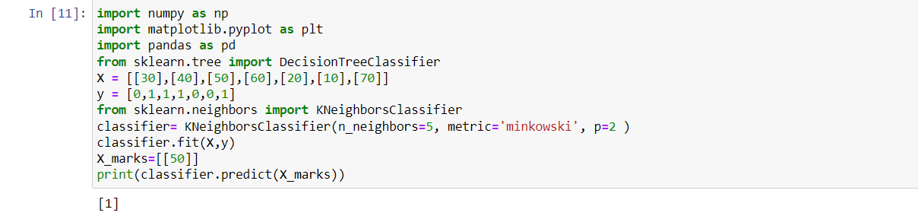
Knn Algorithm

Slide 20
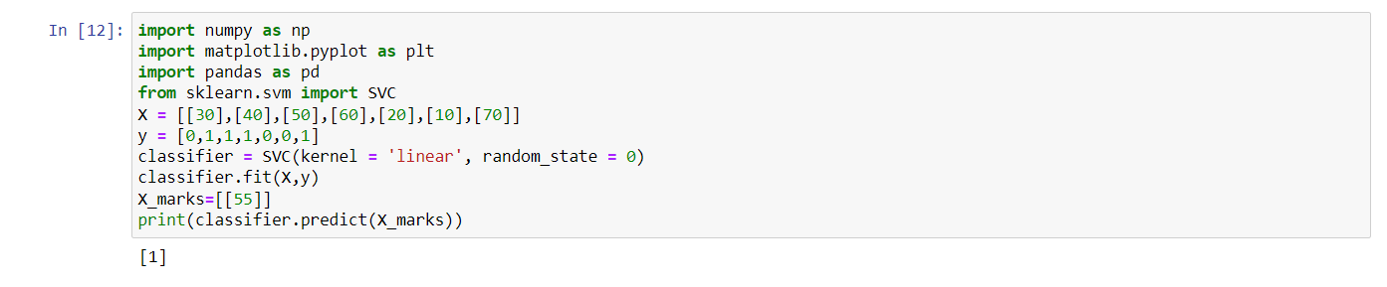
Svm(support vector machine)
It is an algorithm based on supervised learning used for classification as well as regression problems, though it is primarily used for classification problems.

Slide 21
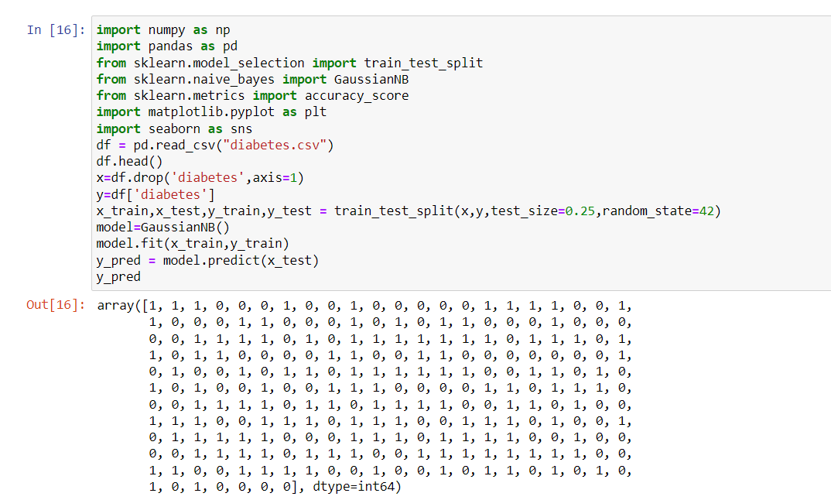
Naïve bayes algorithm – diabetes detection

Slide 22
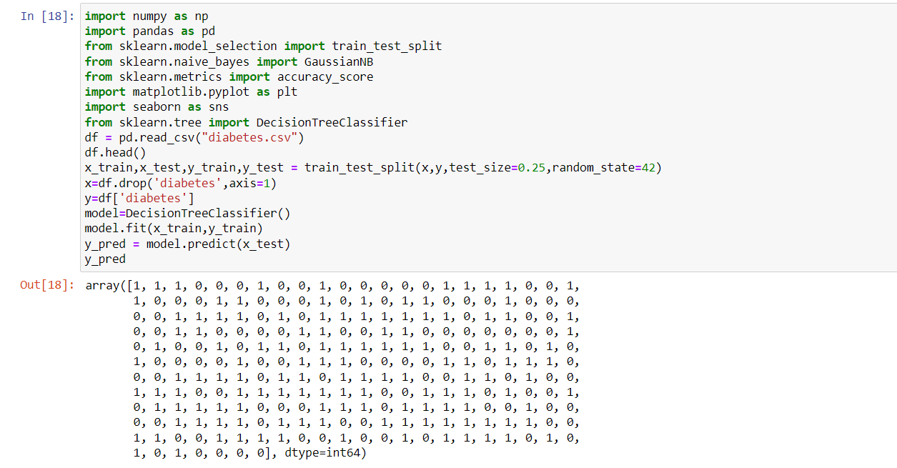
Decision Tree – Diabetes Detection

